Slide 1
Rodeo and Bull Riding: The Culture & Complications
Jennifer FitzPatrick, MD
Sports Medicine Orthopedic Surgery
Pueblo, Colorado
1/16/2016

Slide 2
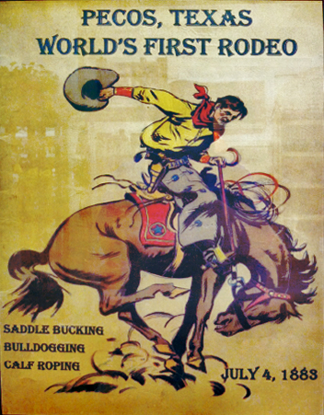
Outline
The Culture
Rodeo Roots
Rodeo Events
The Cowboy / Cowgirl
The unique rodeo athlete
The Complications/Injuries
Acute/Catastrophic Injuries
Chronic Injuries
Impact of Protective Gear

Slide 3
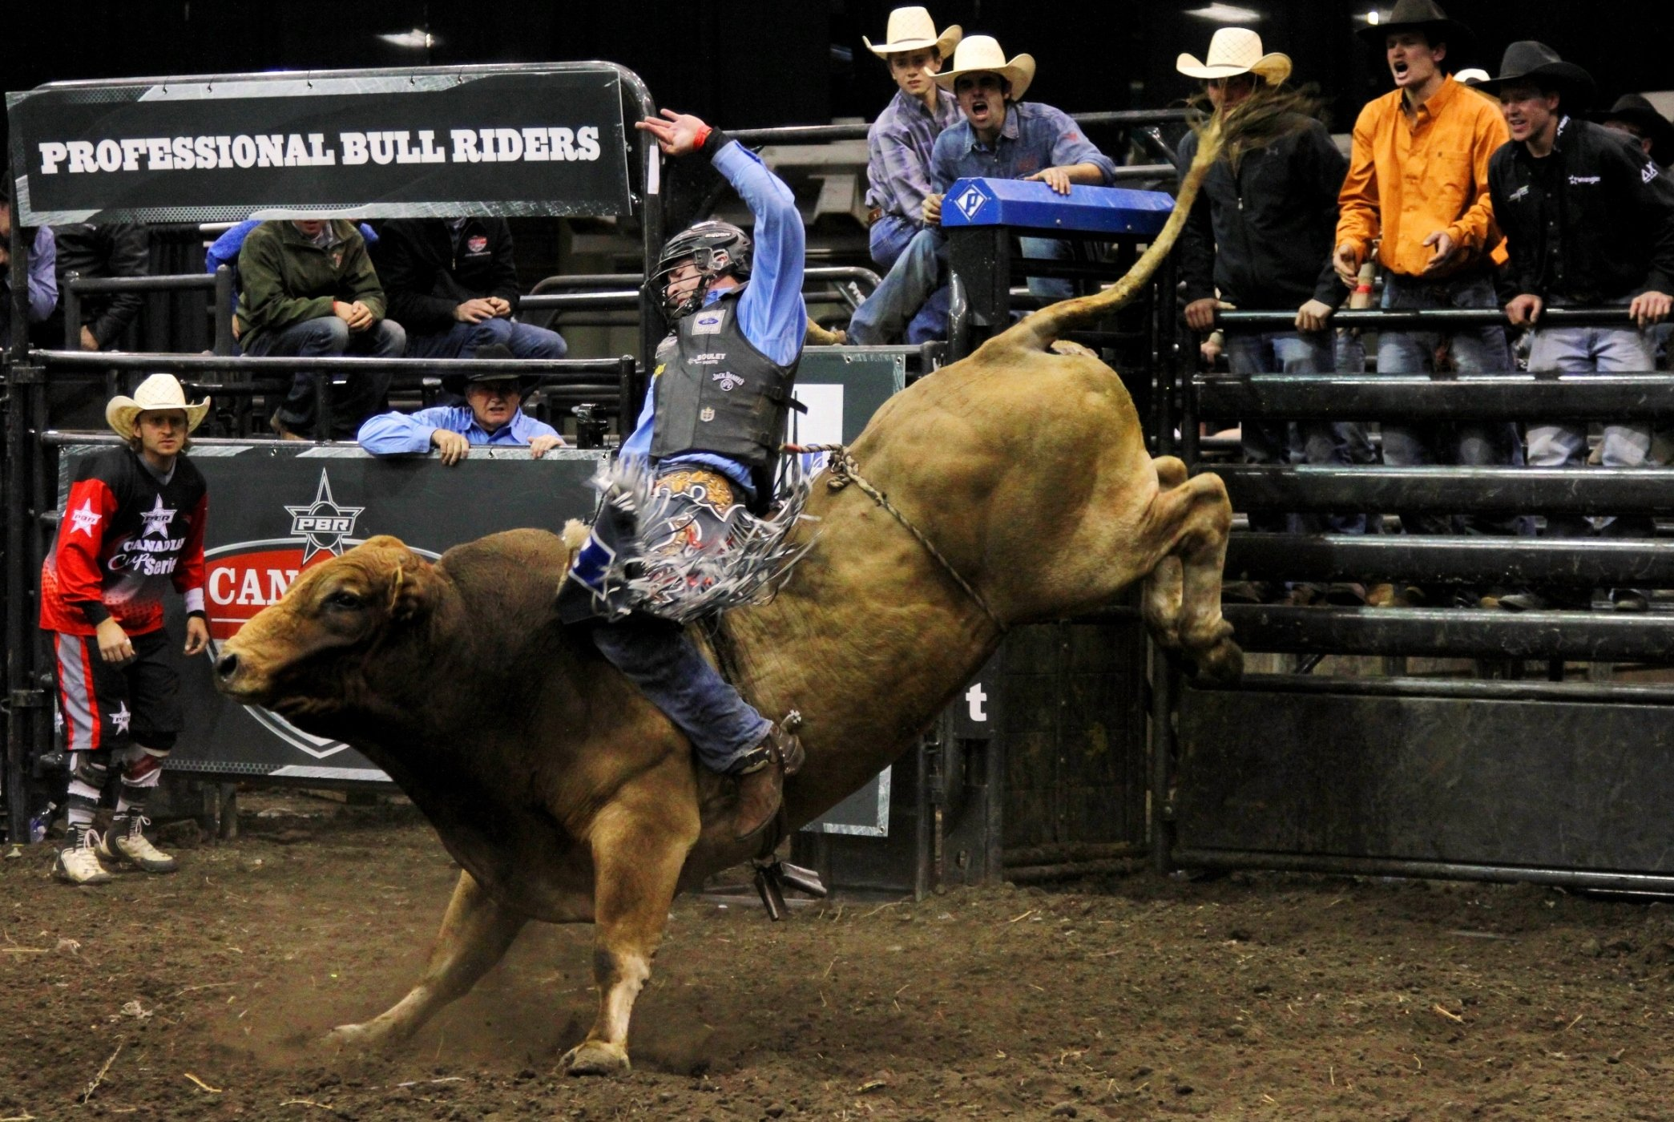
18 yo Bullrider
Treatment?
Return to Sport Guidelines?
Professional obligation?

Slide 4
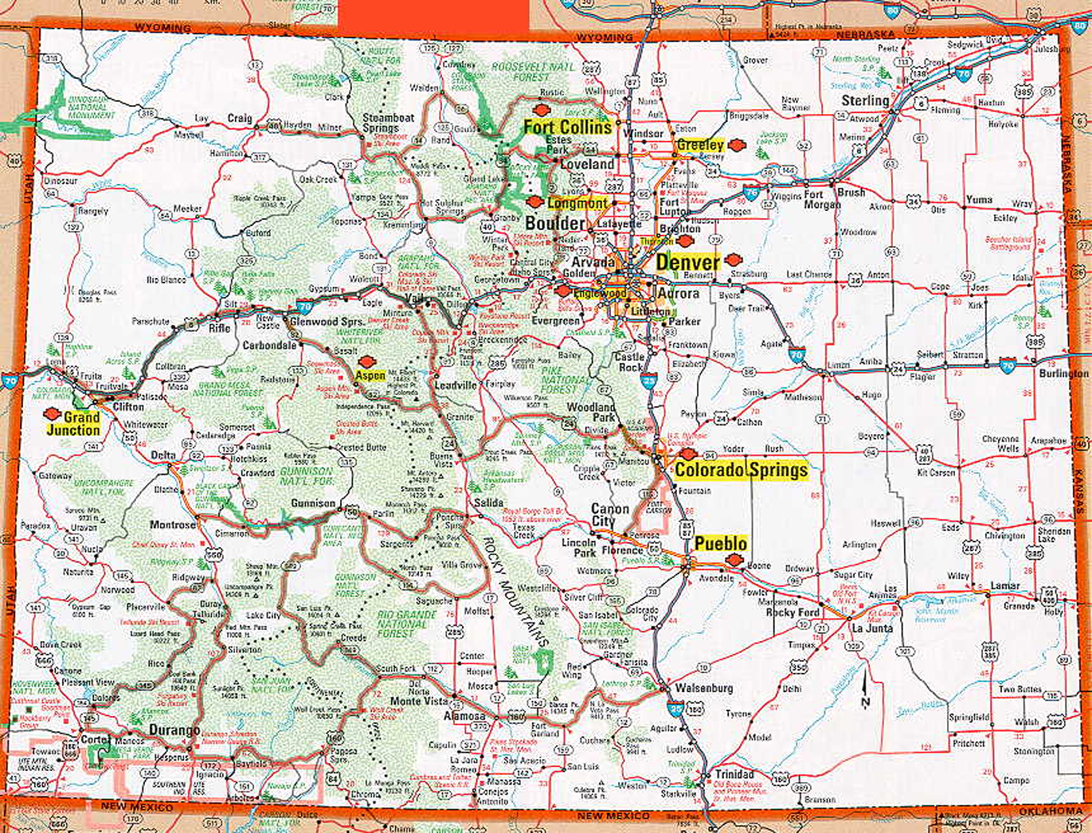
Colorado
Buffalo Bill Memorial Museum
PRCA Headquarters
Pro Rodeo Hall of Fame
NLBRA
PBR Headquarters

Slide 5
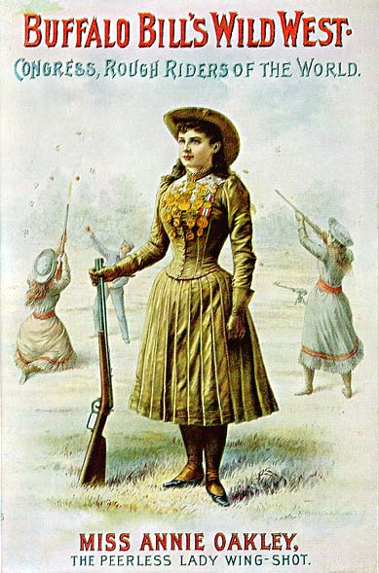
Women in Rodeo
1800’s: American frontier pushed West
Women roping & riding
Late 1800’S: women hired as sharpshooters, trick & stunt horsewomen
Early 1900’s
Celebrated bronc and bull riding competitors
1929: Bonnie McCarroll
Bronc rider died in arena
Women’s participation severely curtailed
Notes:
In the 19th century, women learned to rope and ride as the American frontier pushed West, but "cowboying" as a profession was primarily the job of men and paying jobs in the field were essentially non-existent for women. Women were hired as mounted pistol shooters and as trick and stunt horsewomen in Wild West shows of the late 19th century.^{[1]} In 1885, Annie Oakley was hired by Buffalo Bill Cody as a sharpshooter in his Wild West show, but later helped created the iconic image of the cowgirl when she appeared in a western film shot by Thomas Alva Edison in 1894.^{[2]}
Annie Oakley created the image of the cowgirl for Americans.
In 1903, women began competing at the Cheyenne Frontier Days, though there was never a large number of female professional riders. Rodeo promoters often advertised female riders as sweethearts or queens of the rodeo.^{[3]} The term cowgirl was first used in the context of a wild west show by Oklahoman Lucille Mulhall in 1908 when, at age 10 years, she displayed her roping skills at Madison Square Garden. Prairie Rose Henderson, bronco buster Mabel Strickland, bucking horse champion Bertha Blankett, and other cowgirls achieved celebrity performing in rodeos of the early 20th century. Women competed at the first indoor rodeo at the Fort Worth, Texas, Coliseum in 1918.^{[2]}
1929, bronc rider Bonnie McCarroll died during the Pendleton Round-Up when she was thrown from a horse and dragged around the arena, her foot snagged in a stirrup. Until McCarroll's death, cowgirls had been celebrated for their courage and tenacity in the rodeo arena, but the tragedy escalated the growing opposition to women competing in rough stock events. Rodeo promoters began severely curtailing women's competitive participation and encouraged them instead to serve as rodeo queens.^{[5]}

Slide 6
Notes:
Rodeo is a true American sports. Originally developed in the late 1700 with roots in the southwest from Spanish Americans. The word rodeo has Spanish origins which means “round up”.
Competitive sport that arose out of the working practices of cattle herding in Spain, Mexico, and later the United States, Canada, South America, Australia and New Zealand. It was based on the skills required of the working vaqueros and later, cowboys, in what today are the western United States, western Canada, and northern Mexico. Today it is a sporting event that involves horses and other livestock, designed to test the skill and speed of the cowboys and cowgirls
In Europe it has been banned and there is not the cattle herding practices. Consideration for social concerns.

Slide 7
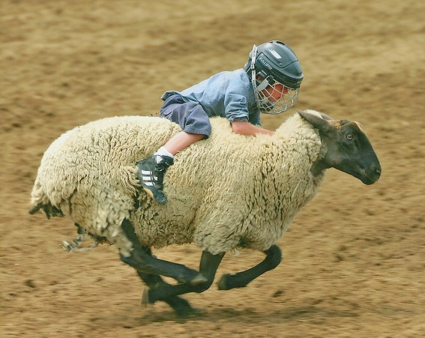
Rodeo Roots
Skills needed for everyday life
Classic Rodeo Events:
Timed Events
Roughstock
Growth of Professional Rodeo:
Encourages younger and younger participants.
Little Britches, High School Rodeo, Collegiate Rodeo
PRCA: 7,500 cowboys compete for $30 million at 650 rodeos
PBR: 700 members from 3 continents & $10 million prizes
Notes:
Competitive sport that arose out of the working practices of cattle herding, rounding up, in Spain, Mexico, and later the United States, Canada, South America, Australia and New Zealand. It was based on the skills required of the working vaqueros and later, cowboys, in what today are the western United States, western Canada, and northern Mexico. Today it is a sporting event that involves horses and other livestock, designed to test the skill and speed of the cowboys and cowgirls

Slide 9
Timed Events
Team Roping
Calf Roping
Steer Wrestling
Barrel Racing
Notes:
Team Roping: “Header” and “Healer” and a steer. The steer is released from a chute and once it reaches a certain point the Header is allowed to use his horse and rope to rope the horns of the steer. The Header then takes his rope and dally’s it around the saddle. This makes the rope taught and he then turns the steer to the left. The Heeler then comes in and ropes the two hind feet. Once the steer is stretched as both horses back up and the steer is immobilized, the time is called. This was originally developed on working ranches to catch a large steer that was too big for one person to capture. For immunizations or branding or other reason.

Slide 10
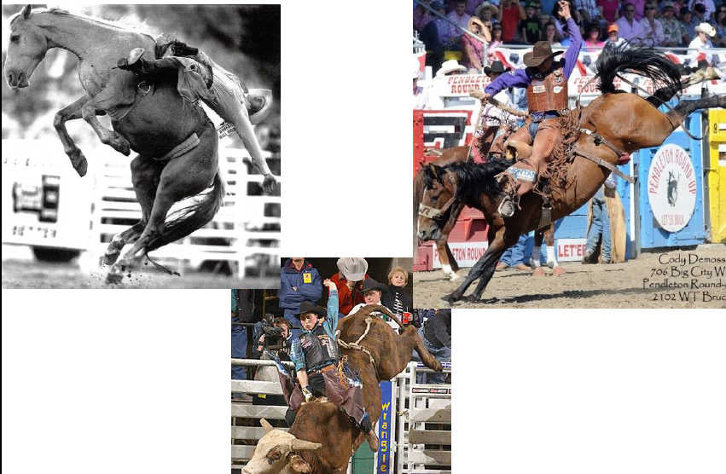
Roughstock Events
Barebronc
Saddlebronc
Bullriding

Slide 11
Notes:
Who are these people and why would they want to do this?
Opening story of flail chest.
Paint the picture of who this person is.
The Flail chest story of college educated, insured, married, production member of society but they have invested their own resources to pursue this sport.
Time and participation money is different.
Good insurance and well educated.

Slide 12
The Rodeo Athlete
1/3 participants are college graduates
Age of athletes-
Lifespan of athlete
If you do not ride- you do not make $
Notes:
Where it has come from and who they are now.
Now in modern era and this is not a dying sport. There is big money and increasing participants.
The Flail chest story of college educated, insured, married, production member of society but they have invested their own resources to pursue this sport.
Time and participation money is different.
Already paid their money to compete at the next event.
No one is covering their initial investment.

Slide 13
The Woman Rodeo Athlete
Catastrophic injuries led to relegation to “Rodeo Queens” and Barrel Racing
WPRCA
Notes:
Wiki data
Why are women doing this?
Talk about Fallon Taylor

Slide 14
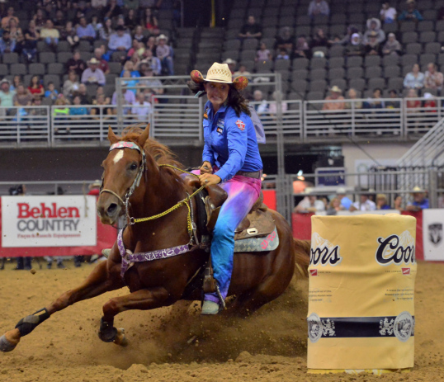
Fallon Taylor- National Barrel Racing Champion 2014

Slide 15
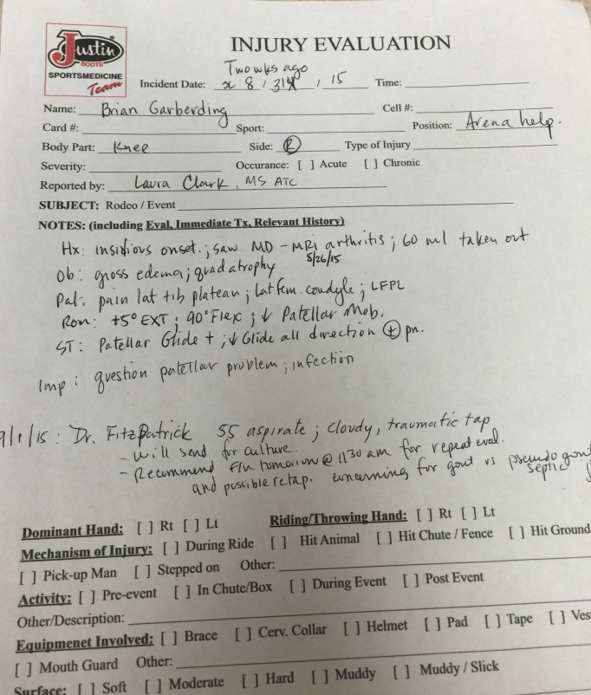
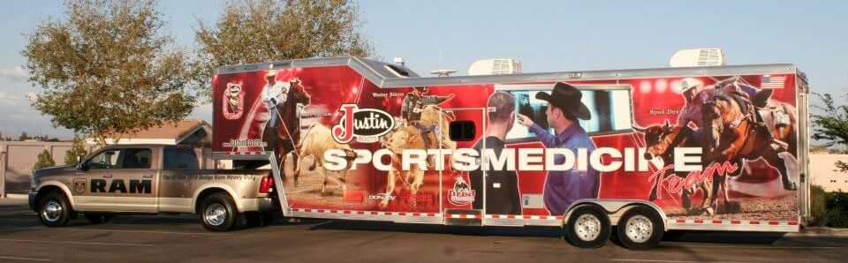
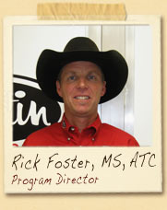
Medical Data Collection
Data Collections of Injury is limited
Transient nature of Competitions
Medical Professionals
Justin Sports Medicine- 1980s

Slide 16
Injuries
Most common event causing injury: Bull Riding (50%)
Followed by bareback (23%) and saddlebronc (15%)
Notes:
Despite limitations in data collection here is what we do know.

Slide 17
Notes:
Some of the studies although a little bit older do show us that….

Slide 18
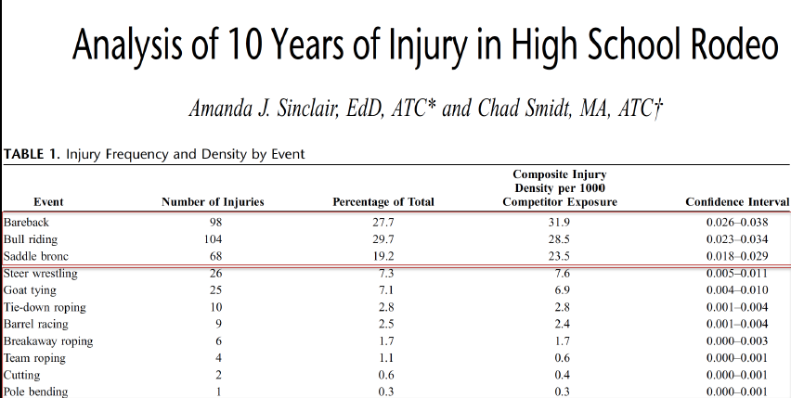
INJURY PREVALANCE
Notes:
Add video

Slide 20
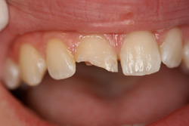
Head and Neck
Concussion: > 50% of all rodeo injury
Identification remains challenging
Only 10% with LOC
Recommendations: withhold rider
1 week and symptom free
No CTE data in Rodeo
Cervical Spine Fx: <2% injuries
Facial Fractures
Dental injury:
Hit against animal’s skull while bucking
Notes:
As the collegiate study highlighted head and neck are the most commonly affected

Slide 21
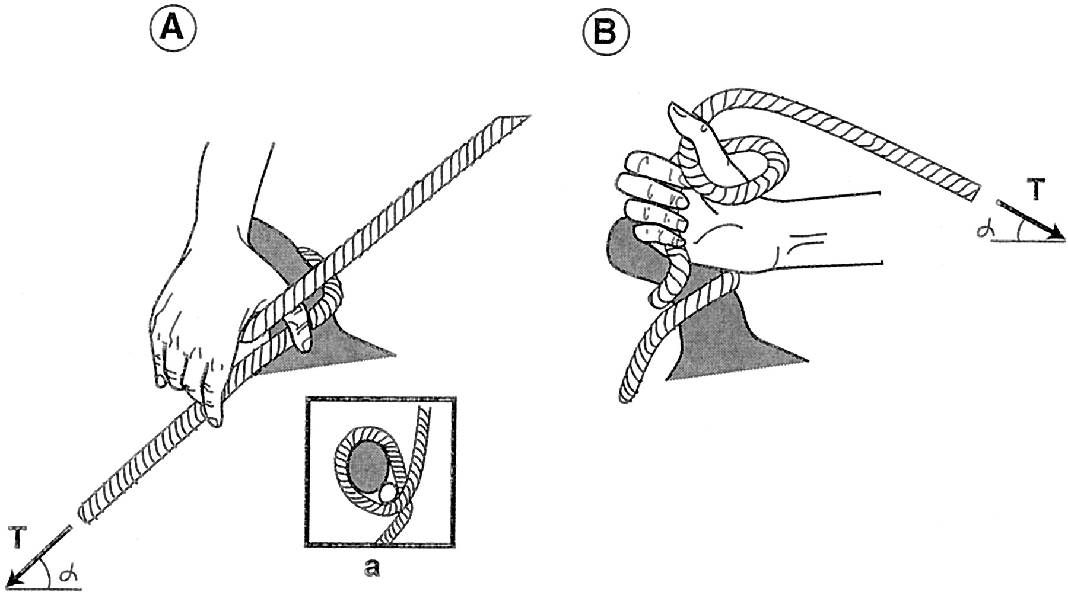
Upper Extremity
Elbow and Below (18%) Shoulder (13%)
Most Common: Shoulder dislocations/fractures
Laterjet: CT scan at 3-4 months
Pectoralis Major Rupture: Steer Wrestling
Thumb avulsion: occurs during “dallying” of roping events
Rider wraps the coils of rope around the saddle horn
Notes:
Steer wrestling: pectoralis major rupture

Slide 22
Team Roping

Slide 24
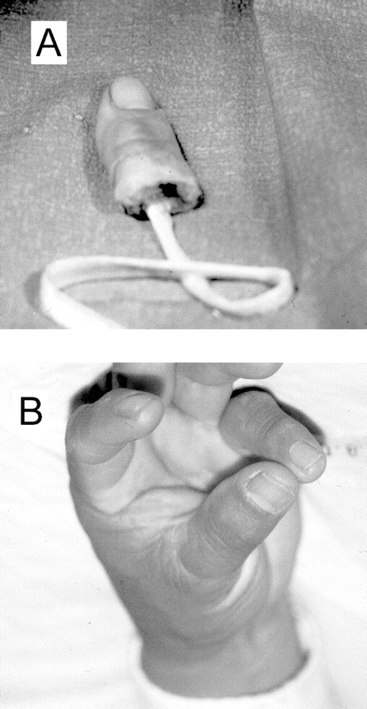
Successful Replantation
Notes:
Versus more recent injury of Thumb amputation.
Mention antibiotic management as well given the high risk for infection.

Slide 25
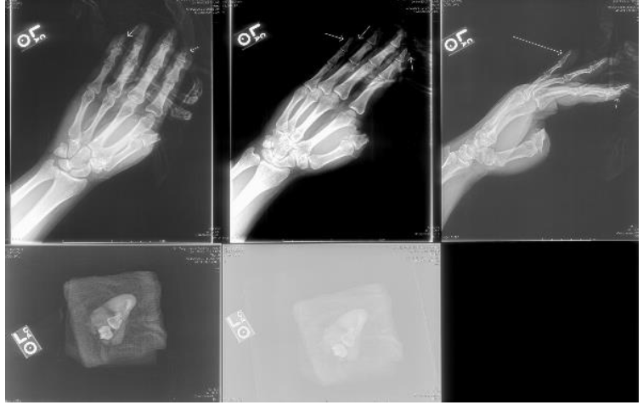

Slide 26
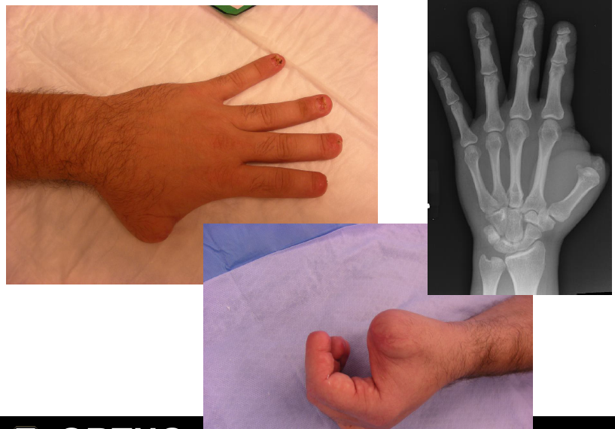

Slide 27
UE: Roughstock Injuries
25 College NFR Athletes
Age: 21 ± 1.4 yrs
82 Injuries
24 UE fractures (5 nonunions)
Ulnar hypertrophy
Elbow hyperextension/dislocation
Scapholunate dissociation, TFCC injuries
Second MC bossing
Chronic elbow/wrist findings- loose bodies, olecranon tip fx
Myers et al. Radiographic findings of the UE in College Rodeo Athletes. 2003

Slide 28
Lower Extremity Injuries
Knee (10%) and Ankle (6%) injuries are the most common
Secondary to dismount and being stepped on
Mostly ligamentous
ACL/PCL
May return to competition if xray negative

Slide 29
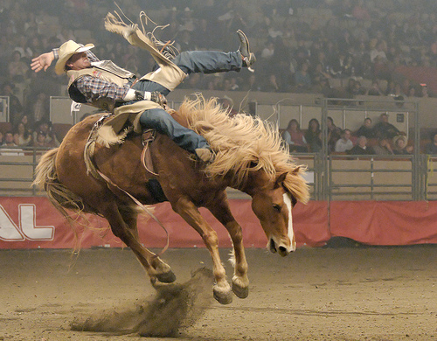
Case: Bareback Riding

Slide 30
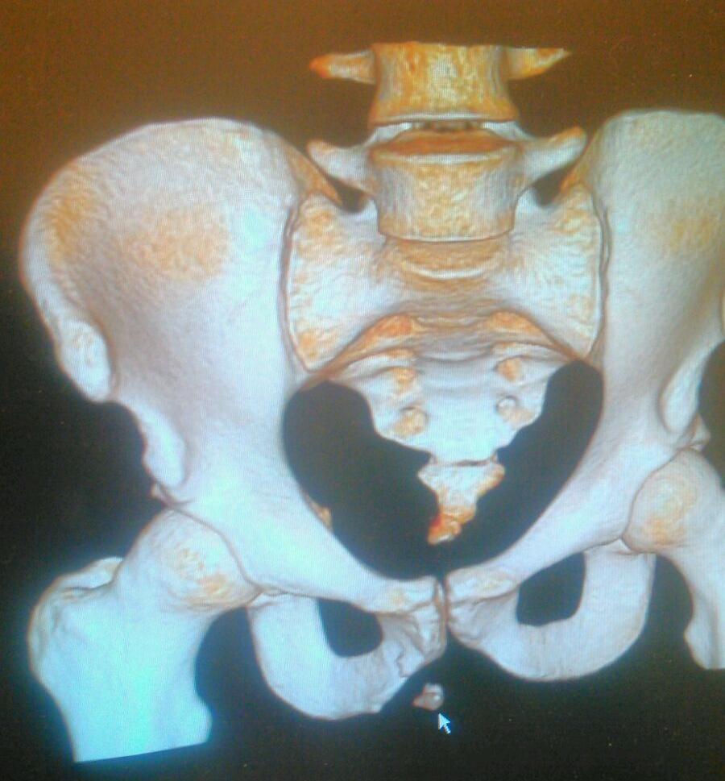
Adductor Avulsion Fracture
Notes:
Initial injury January 2013
20 yo Bareback rider with groin strain. Pain with bareback riding. Swelling in iscshial tuberosity region. Rider for 2 years and then decided to have it worked up. Required surgical removal. Back to riding 3 weeks later.

Slide 31
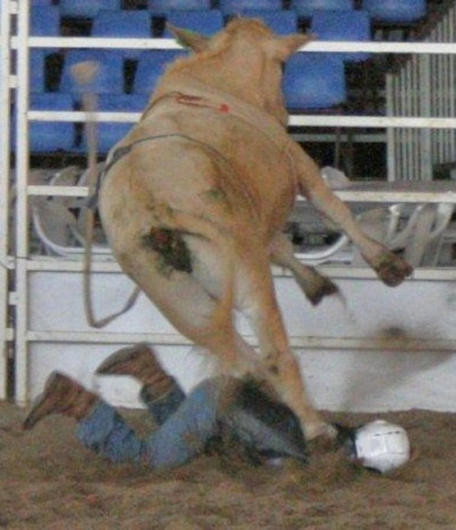
Torso Injuries
28% of Injuries
Identify any trampled or kicked athlete as having a potentially life threatening injury
Goring injury by bull’s or steer’s horns
Spleen injury, rib fracture, pneumothorax,
Pelvic Fracture
Notes:
13 yo treated for pneumothorax

Slide 32
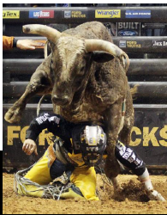
Rodeo Catastrophic Injury Registry (RCIR)
Established 2007 (retrospective 1989)
Thoracic Compression- most common fatal mechanism.

Slide 33
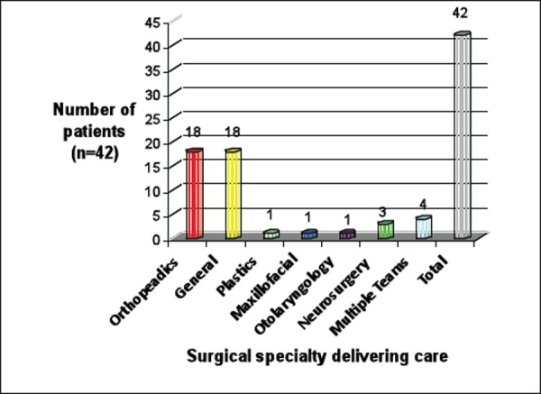
Who Takes Care of these Injuries?
Number of admitted patients treated by surgical specialties
Notes:
Who responds to surgical management?

Slide 34
Lane Frost
Notes:
Video of lane frost

Slide 35
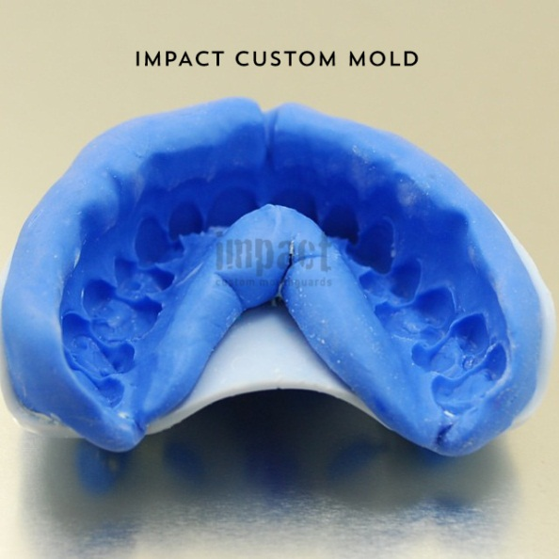
Injury Prevention Initiated
Notes:
Different the NFL: where they say I am not going to ride today without a helmet.
One question would be how to fund this protective gear. Could the hall of fame group and industry sponsors to pay for it.
Not only are there mechanical ways for injury prevention but we also have personnel.
These people are key in the injury prevention and having the right person at the right time can be the difference between life and death.

Slide 36
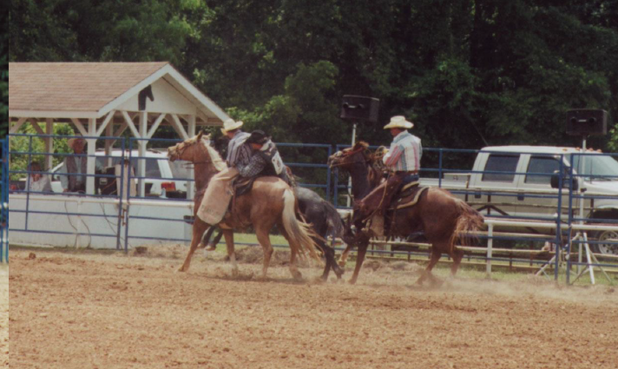
Personel Prevention Mechanisms
Rodeo Clown/ Bull fighter
Additional rider to get the athlete off

Slide 39
Back to our 18 yo Bullrider
Notes:
Would you have treated this fracture this way?

Slide 40
Notes:
Good this is a young healthy patient with good biology that was able to heal this fracture before he was able to re-break it at this time.
Future repetitive use or trauma injuries will remain to be seen

Slide 41
Summary
Rodeo is one of the fastest growing sports
The athlete, culture & expectations are unique
Identify any trampled or kicked athlete as having a potentially life threatening injury
Utilize extra caution (fixation) given the demands
Encourage protective gear- helmet, mouth guard, vest

Slide 42
Future Developments
Define injury rates
Improve data collection
Create culture of prevention
Rodeo Conditioning programs
Improve continuity of care
Increase health care professional rodeo knowledge

Slide 43
Opportunity to Participate
State/County Fair Schedules or Livestock events
Outreach to local youth groups: 4H, FFA, Little Britches Association
Justin Sports Medicine

Slide 44
Rodeo Vocabulary
"Down in the Well" [doun in th'uh wel]The expression "down in the well" is used by bull riders to describe a situation in which a bull is spinning in one direction and the force of the spin pulls the rider down the side of the bull into motion's vortex. This is a dangerous scenario that often results in a bull rider getting hung up to the bull.

Slide 45
Rank
A bull that is difficult to ride is considered "rank."

Slide 46
Vocabulary
Eight Seconds: amount of time a bull rider must stay aboard his bull to receive a score. During the eight-second ride, the bull rider cannot touch his free hand to the bull or himself or he will be disqualified.

Slide 47
Vocabulary
Hung up: Sometimes a rider gets tossed from a bull but is unable to free his riding hand from his bull rope and therefore is "hung up" to the bull. When this dangerous scenario occurs, the bullfighters often move in to help the bull rider free his hand from his rope and get away from the bull.

